Slide 1
Statistical Methods for Data Analysis
Random number generators
Luca Lista
INFN Napoli

Slide 2
Pseudo-random generators
Requirement:
  Simulate random process with a computer
    E.g.: radiation interaction with matter, cosmic rays, particle interaction generators, …
    But also: finance, videogames, 3D graphics, ...
Problem:
  Generate random (or almost random…) variables with a computer
  … but computers are deterministic!

Slide 3
Pseudo-random numbers
Definition:
  Deterministic numeric sequences whose behavior is not easily predictable with simple analytic expressions
  (Re-) producible with an algorithm based on mathematical formulae
Statistical behavior similar to real random sequences

Slide 4
Example from chaos transition
Let’s fix an initial value x₀
Define by recursion the sequence:
    x_{n+1} = λ x_{n} (1 – x_{n})
Depending on λ, the sequence will have different possible behaviors
If the sequence converges, we would have, for n→∞ the limit x solving the equation:
  x = λ x (1 – x) ⇒ x = (1- λ)/ λ, 0

Slide 5
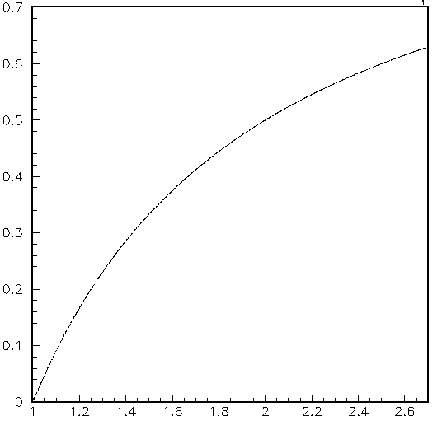
Stable behavior
Actually, for sufficiently small λ starting from:
x₀ = 0.5
the sequence converges
x_{n}
n > 200
λ

Slide 6
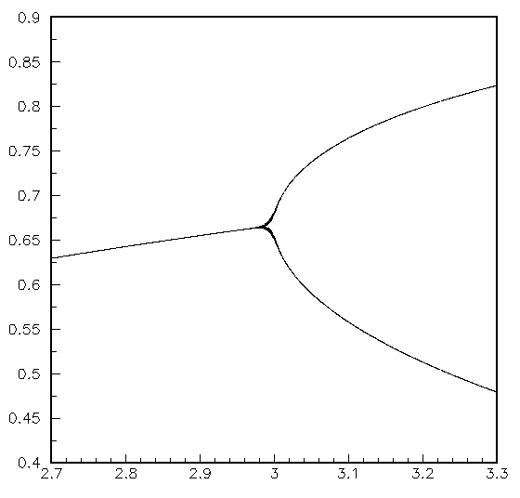
Bifurcation
For λ > 3
the series does not converge, but oscillates between two values:
  x_{a} = λ x_{b} (1 – x_{b})
  x_{b} = λ x_{a} (1 – x_{a})
x_{n}
n > 200
λ

Slide 7
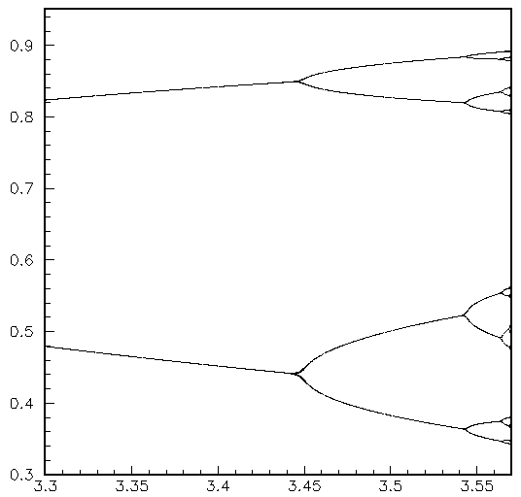
Bifurcation II, III, …
Bifurcation repeats when λ grows
Sequences of 4, 8, 16, … repeating values
x_{n}
n > 200
λ

Slide 8
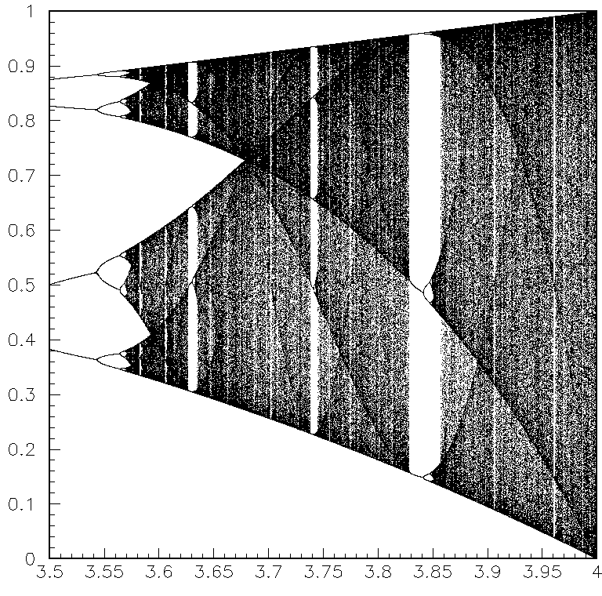
Chaotic behavior
For even larger λ the sequence is unpredictable.
For instance, for λ=4 values densely fills the interval [0, 1]
x_{n}
200 < n < 100000
λ

Slide 9
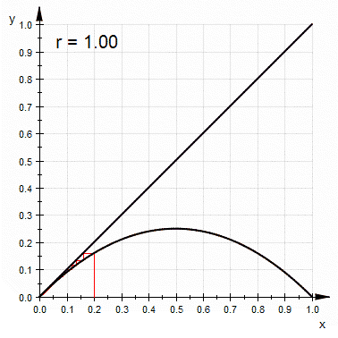
Transition to chaos

Slide 10
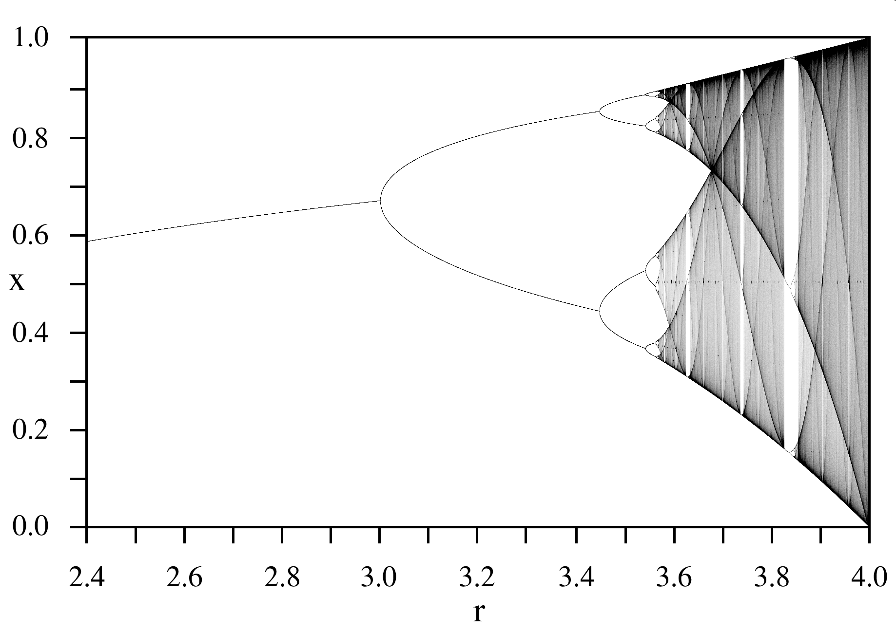
Another complete view

Slide 11
Properties of Random Numbers
A ‘good’ random sequence:
  {x₁, x₂, …, x_{n}, …}
should be made of elements that are independent and identically distributed (i.i.d.) :
  P(x_{i}) = P(x_{j}), ∀ i, j
  P(x_{n} | x_{n−1}) = P(x_{n}), ∀ n

Slide 12
(Pseudo-)random generators
The standard C function drand48 is based on sequences of 48 bit integer numbers
The sequence is defined as:
  x_{n+1} = (a x_{n} + c) mod m
where:
  m = 2⁴⁸
  a = 25214903917 = 5DEECE66D (hex)
  c = 11 = B (hex)
man drand48 for further information!
Those numbers give a uniform distribution

Slide 13
Pseudo-random generators
To convert into a floating-point number, just divide the integer by 2⁴⁸.
The result will be uniformly distributed from 0 to 1 (with precision 1/2⁴⁸)
drand48, mrand48, lrand48 return random numbers with different precision using a sufficiently large number of bits from the main integer sequence

Slide 14
Random generators in ROOT
TRandom (low period: 10⁹)
TRandom1 (‘Ranlux’, F.James)
TRandom2 (period: 10²⁶)
TRandom3 (period: 2¹⁹⁹³⁷−1)
ROOT::Math generators
  GSL based, relatively new
See dedicated slides

Slide 15
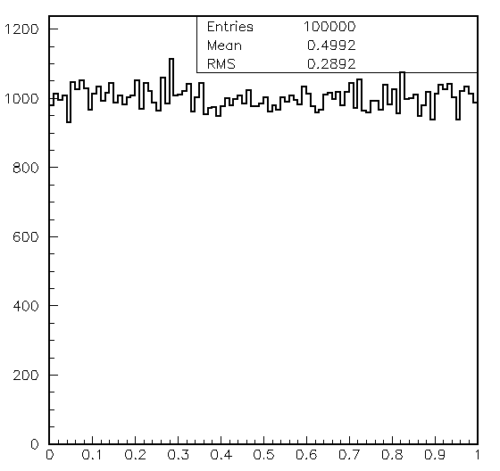
Probability distribution
Within precision, the distribution is uniform (flat)
δn / δr
r = drand48()

Slide 16
Non uniform sequences
In order to obtain a Gaussian distribution: average many numbers with any limited distribution
  Central limit theorem
    r = 0;
    for ( int i = 0; i < n; i++ )
    r += drand48();
    r /= n;
  Works, but inefficient!

Slide 17
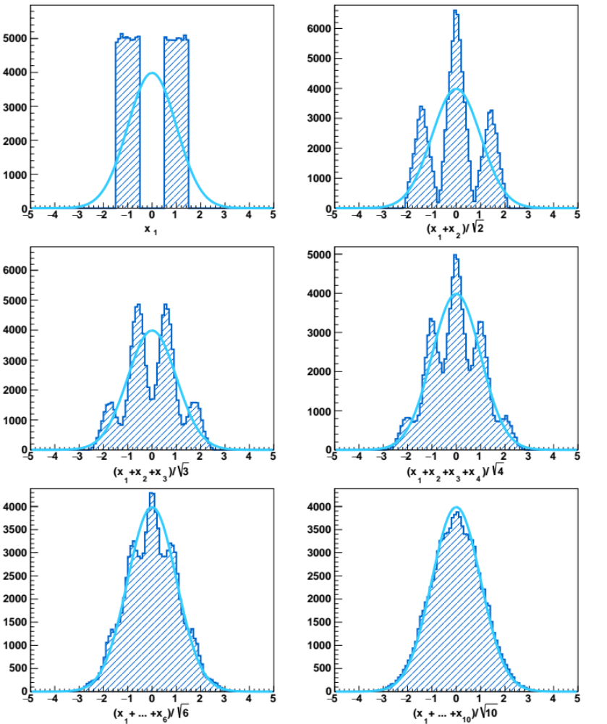
Distribution of ¹/_{n}Σ_{i=1,n} r_{i}

Slide 18
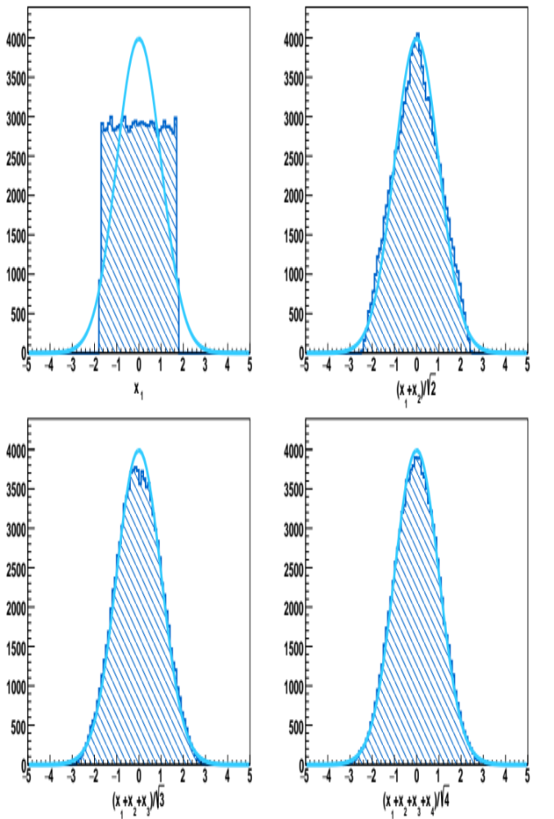
Comparison with true Gaussians

Slide 19
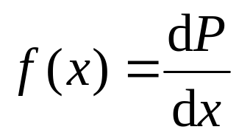
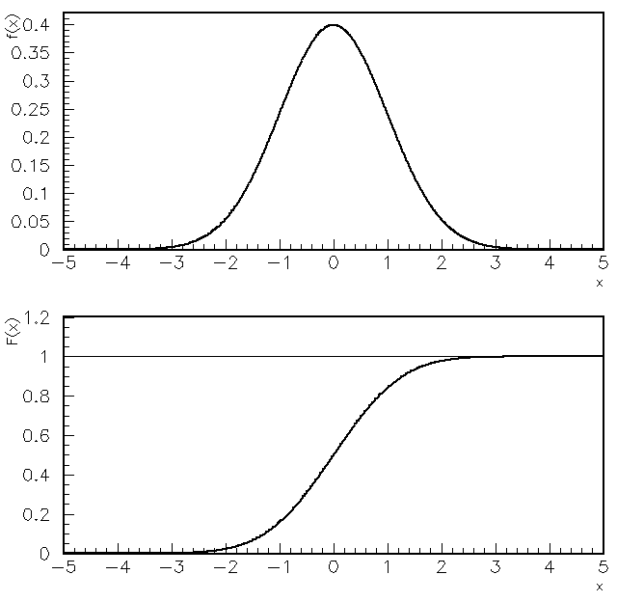
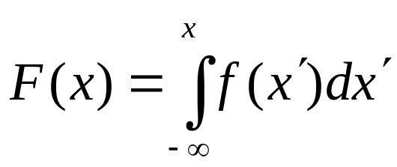
Generate a known PDF
Given a PDF:
Its cumulative distribution is defined as:

Slide 20
Inverting the cumulative
If the inverse of the cumulative distribution is known (or easily computable numerically) a variable x defined as:
    x = F⁻¹(r)
is distributed according to the PDF f(x) if r is uniformly distributed between 0 and 1

Slide 21
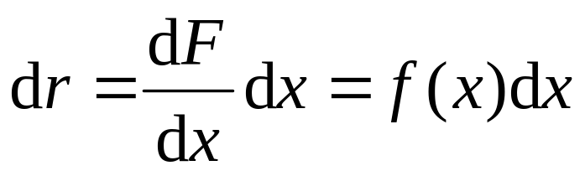
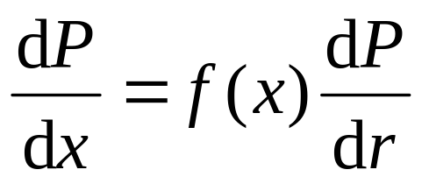
Demonstration
As r = F(x), then:
hence:
If r has a uniform distribution, then
dP/dr = 1, hence dP/dx = f(x)

Slide 22
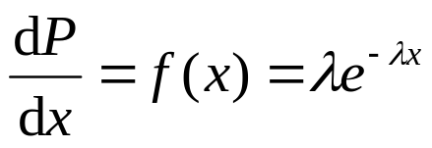
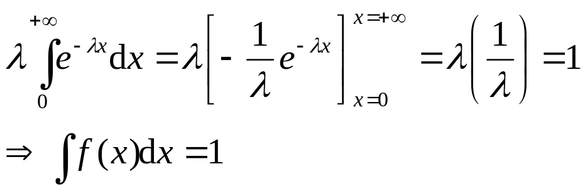
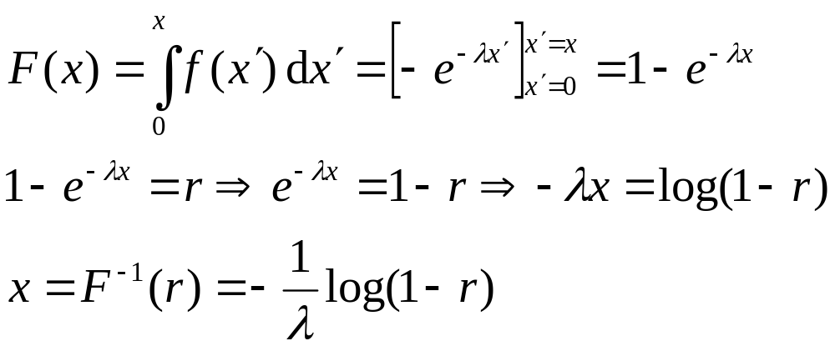
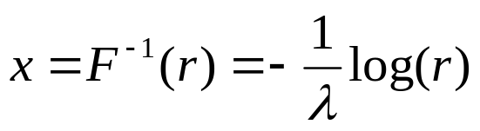
Example
Exponential distribution:
Normalization:
1−r and r have both
uniform distribution
between 0 and 1

Slide 23

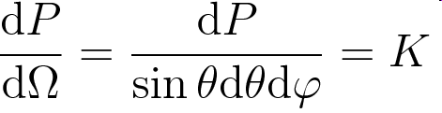
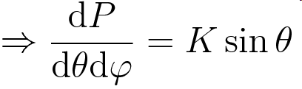
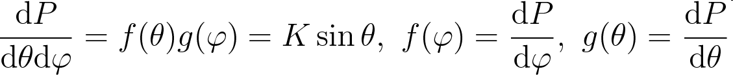
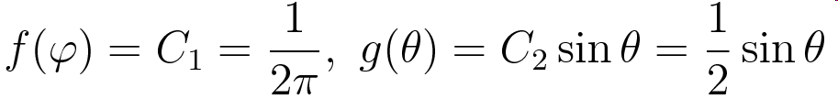
Generate uniformly over a sphere
Generate θ and ϕ.
Factorize the PDF:

Slide 24
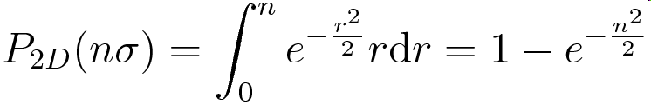
Generating Gaussian numbers
Gaussian cumulative not easily invertible (erf)
Solution:
  Generate simultaneously two independently Gaussian numbers
From the inversion of 2D radial cumulative function:
Box-Muller transformation:
  float r = sqrt(-2*log(drand48());
  float phi = 2*pi*drand48();
  float y1 = r*cos(phi), y2 = r*sin(phi);
Other faster alternative are available (e.g.: Ziggurat)

Slide 25
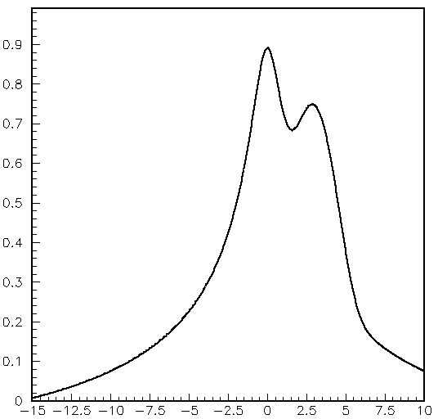
Hit or miss Monte Carlo
Reproduce a generic distribution:
Extract x flat from a to b
Compute f = f(x)
Extract r from 0 to m,
where m ≥ max_{x} f(x)
If r > f repeat extraction,
if r < f accept
In this way, the density
is proportional to f(x)
May be inefficient if the
function is very peaked!
Finding maximum of f may be slow in many dimensions
f(x)
m
miss
hit
a
x
b

Slide 26
Example: compute an integral
double f(double x){
return pow(sin(x)/x, 2);
}
int main() {
const double a = 0, b = 3.141592654, m = 1;
int tot = 0;
for(int i = 0; i < 10000; ++i) {
do {
double x = a + (b – a) * drand48();
double ff = f(x);
++tot;
double r = drand48() * m;
} while (r > ff);
}
double ratio = double(hit)/double(tot);
double error = sqrt(ratio * (1 – ratio)/tot);
double area = (b – a) * m * ratio;
return 0;
}

Slide 27
Importance sampling
The same method can be repeated in different regions:
Extract x in one of the
regions (1), (2), or (3) with
prob. proportional to the
areas
Apply hit-or-miss in the
randomly chosen region
The density is still prop.
to f(x), but a smaller number
of extraction is sufficient
(and the program runs
faster!)
Variation: use hit or miss within
an “envelope” PDF whose cumulative
has is easily invertible…
f(x)
m
2
3
1
a₀
a₁
a₂
x
a₃

Slide 28
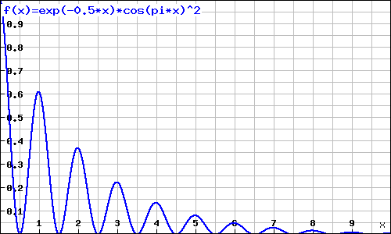

Exercise
Generate according to the following distribution (0 ≤ x < ∞):

Slide 29
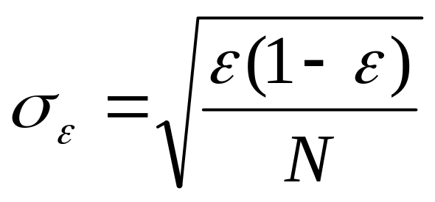
Estimate the error on MC integral
MC can also be a mean to estimate integrals
Accepting n over N extractions, binomial distribution can be applied:
    σ_{n}² = Nε(1− ε)
Where ε = n/N is the best estimate of ε.
The error on the estimate of ε is:
σ_{ε} ² = σ_{n/N} ² = ε(1− ε)/N

Slide 30
Multi-dimensional integral estimates
The same Monte Carlo technique can be applied for multi-dimensional integral estimates, extracting independently the N coordinates (x₁, …, x_{n})
The error is always proportional to 1/√N, regardless of the dimension N
  This is and advantage w.r.t. the standard numerical integration
Difficulties:
  Finding maximum of f numerically may be slow in many dimensions
  Partitioning the integration range (importance sampling) may be non trivial to do automatically

Slide 31
References
Logistic map, bifurcation and chaos
  http://en.wikipedia.org/wiki/Logistic_map
PDG: review of random numbers and Monte Carlo
  http://pdg.lbl.gov/2001/monterpp.pdf
GENBOD: phase space generator
  F. James, Monte Carlo Phase Space, CERN 68-15 (1968)

